Slide 1
BIFX 503: Statistics for Bioinformatics
Instructor: Jennifer Schroeder, Ph.D.
Wednesdays, 5:30-8:00pm
Hodson Technology Center, Room 237
Fall 2021

Slide 2
Linear Regression

Slide 3
Content
Simple linear regression
Multiple linear regression
Interaction and Confounding
Model fitting strategies
Polynomial regression

Slide 4
Simple Linear Regression
ΔY
β₀
ΔX
Y = β₀ + β₁X + e
X and Y are independent and dependent variables, respectively
β₀ is the intercept of the line: a constant representing the value of Y when X=0
β₁ is the slope of the line: the change in Y associated with a one-unit change in X, or ΔY/ΔX
e is a random variable representing the error of prediction

Slide 5
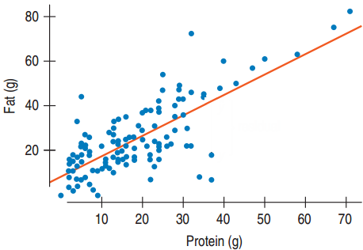
Regression Coefficients
Linear regression calculates the equation for a “best fit” line that passes through the data points
Estimated intercept and slope, and the precision of each estimate

Slide 6

Interpreting Regression Coefficients
Slope = 0.91: an item with one more gram of protein is expected to have 0.91 additional grams of fat
y-intercept = 8.4: an item with no grams of protein is expected to have 8.4 grams of fat.

Slide 7
Linear Regression Assumptions
Subjects are independently observed, and representative of one population
Each subject has both X and Y
X and Y measured independently
X and Y have a Normal distribution
The relationship between X and Y is linear

Slide 8
Linear Regression Limitations
Regression results can be highly influenced by outliers
Outliers have more leverage in a small sample
Always precede regression analysis by graphing data
Histograms of each variable: Normal?
Scatterplot of both: Linear?

Slide 9
Regression Results
Estimated coefficients
Quantifies its association with the outcome
Standard error of each coefficient
Quantifies the precision of the estimate
Hypothesis test for each coefficient (t tests)
Is the coefficient different from zero?
Zero means no association between X and Y
Overall model fit (R squared)
R² is the fraction of the data’s variation that is accounted for by the regression model

Slide 10
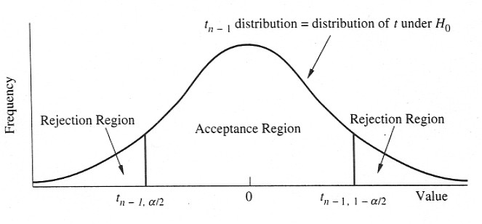
Hypothesis Testing in Regression
Regression coefficients follow a t distribution with n-2 df
You use a one-sample t test to test the hypothesis
H₀: β = 0 vs.
H₁: β ≠ 0
H₀ is more likely to be rejected the further r is from zero (and the further t is from zero).

Slide 11
Confidence Intervals in Regression
Confidence intervals can be calculated for a regression coefficient using the following formula:
b ± t_{α(2),n-2}SE(b)

Slide 12
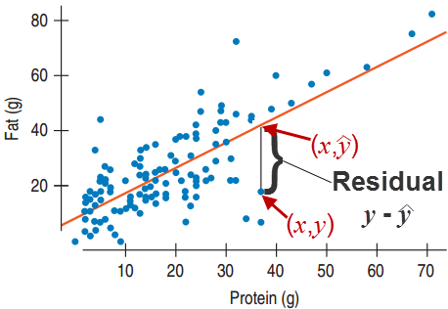



Residuals
$$\hat{y}$$
is called the predicted value.
For each point (x,y) look at the point on the line with the same x-coordinate.
The residual is defined by
The residual is the difference between the observed value and the predicted value.
$$\left(x,\hat{y}\right)$$
$$y−\hat{y}$$

Slide 13
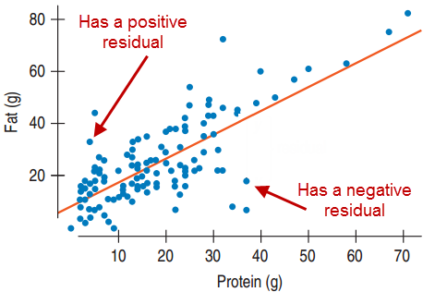
Meaning of Residuals
The residual is the difference between the observed data point y and the value predicted by the regression model ŷ

Slide 14
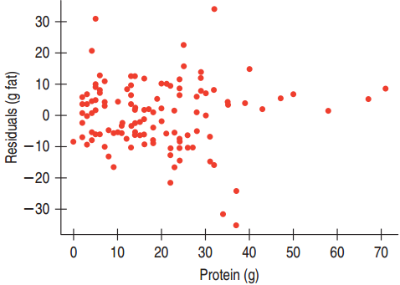
A Good Regression Model
Residual scatterplot looks like random scatter
No obvious pattern: no shape or outliers
R² indicates a good portion of the data’s variation is captured by the model

Slide 15
Linear Regression in R
lm(y ~ x, data)
Performs linear regression
Output: coefficients only
summary(lm(y ~ x, data))
Detailed output, including hypothesis test for each coefficient and model fit indices (R²)
confint(lm(y ~ x, data))
Confidence bounds on parameter estimates

Slide 16
Linear Regression in R
Can use a subset argument to limit analysis to a portion of data
lm( …, subset = Sex == F)

Slide 17
Residuals Plot: Easy Way
Using the plot function, which=X argument
E.g., plot(lm(y ~ x, data), which=1)
1: Residuals vs. fitted values
Should look like random scatter
2: Normal QQ plot of standardized residuals
Should look like diagonal line through the origin
3: Fitted values vs. sqrt standardized residuals
4: Needle plot of Cook’s distance
Identifies observations that may have undue influence
5: Residuals vs. leverage
6: Cook’s distance vs. leverage

Slide 18
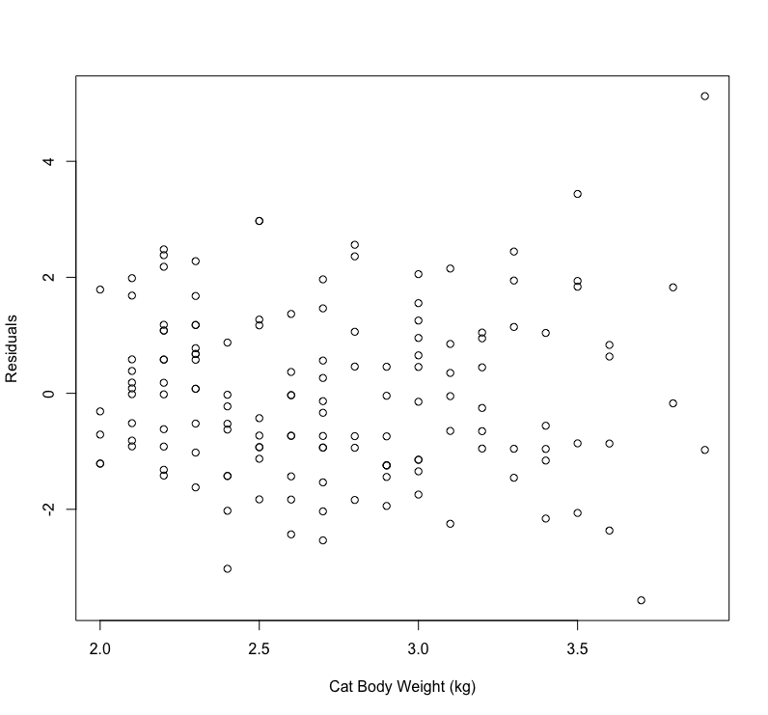
Residuals Plot: DIY Way
catfit <- lm(Hwt ~ Bwt, cats)
catres <- resid(catfit)
plot(cats$Bwt, catres, xlab = "Cat Body Weight (kg)", ylab = "Residuals")

Slide 19
Example: Cat Anatomy
Data cats
Evaluate the association between cat body weight and heart weight using linear regression:
Estimate the equation for the line
Evaluate the model in terms of R² and residuals
Interpret the meaning of the regression model (intercept and slope)

Slide 20
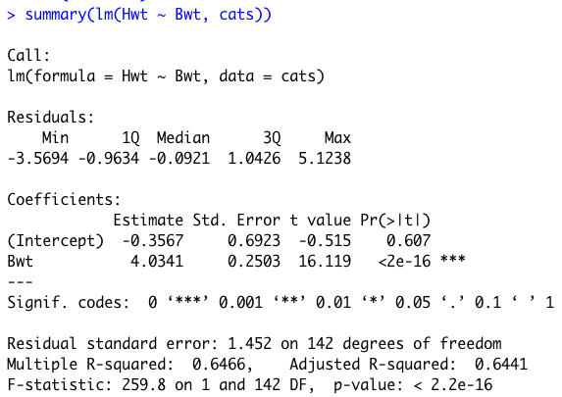
Example: Cat Anatomy
Equation for line: Hwt = -0.36 + 4.03Bwt + error
R² indicates 65% of variability in Hwt is explained by variability in Bwt (this is fairly high for a regression model
Residuals plot looks like fairly random scatter but there may be a few outliers
Interpretation: for each 1kg increase in Bwt, Hwt increases by 4g

Slide 21
Class Exercise: Trees
Data trees
Evaluate the association between each pair of variables using linear regression:
Estimate the equation for the line
Evaluate the model in terms of R² and residuals
Interpret the meaning of the regression model (intercept and slope)

Slide 22
Independent Variable Types
Independent variables in regression can be quantitative or categorical
Categorical variables can be either
Binary
Multilevel

Slide 23
Categorical Independent Variables
Categorical independent variables need a reference category
The reference category is the one that the other levels are compared to
Regression coefficient slope is interpreted as change in Y associated with X being different from the reference category

Slide 24
Binary Independent Variables
Dichotomous independent variables (e.g. Male/Female), the reference category is usually that which comes earlier in the alphabet (Female)
Override this by defining your variable as an ordered factor
Reference category is lowest order
Alternatively, recode the variable as 0/1
0=male, 1=female
Reference category is the one coded zero

Slide 25
Multilevel Independent Variables
For multilevel independent variables, each category is compared to the reference category
E.g., North, South, East, West
Default: each compared to East
Ordered factor syntax:
factor(data$region, levels = c(”North", ”South”, “East”, “West”), ordered = TRUE)

Slide 26
Dummy Variable Coding
A multilevel categorical variable with n categories becomes n-1 binary variables
E.g., Low-Med-High becomes:
Med Yes (1) or No (0); High Yes (1) or No (0)
Low is the reference category and occurs when Med=0 and High=0

Slide 27
Example: Cat Anatomy
Dataset cats
Evaluate the association between cat body weight and sex using linear regression
First create a binary 0/1 variable for sex
Fit the model
Interpret the meaning of the regression model (intercept and slope)

Slide 28
Example
summary(lm(Bwt ~Sex, cats))
cats$Female[cats$Sex == “M”] <- 0
cats$Female[cats$Sex == “F”] <- 1
summary(lm(Bwt ~ Female, cats))

Slide 29
Multiple Linear Regression

Slide 30
Multiple Linear Regression
Motivation: adding independent (X) variables improves the quality of the model in terms of
Explanation
Prediction

Slide 31
Associations Between Three or More Variables
Frequently a third variable is of scientific interest
You want to see how a third variable affects the relationship between the other two variables
Interaction
You want to assess the relationship between two variables while holding a third variable constant
Confounding

Slide 32
Interaction vs. Confounding
Interaction
is a real phenomenon that generalizes to the population from which your sample is drawn
is of scientific interest
Confounding
is due to distortion, and true only in the context of your sample
needs to be corrected in order to accurately assess the relationships of interest

Slide 33
Multiple Linear Regression
More than one IV predict the DV:
Y is the DV
X₁, X₂, …, X_{k} are the IVs
β₀ is the intercept
β₁ , β₂, …, β_{k} are the slopes
e is error

Slide 34
Interpretation of Results
Regression output provides a parameter estimate for each IV in the model (β’s)
β quantifies the strength of association between each IV and the DV, after accounting for all other IVs
The sign of β indicates whether the association is positive of negative
The magnitude of β is the change in the DV that would be expected from a one-unit change in the IV, if all other IVs are held constant
The precision of each parameter estimate is also provided:
Standard error, confidence intervals
Statistical test (H₀: β=0)

Slide 35
Inference
Overall model
Adjusted R² – proportion of variance of the DV that is explained by the IVs (larger is better)
ANOVA Table
F test: overall model fit (smaller p value is better)
MS_{residual}: sum of squared residuals, divided by df (smaller is better)
Contribution of individual IVs
t-test to determine if coefficient=0
confidence limits on the coefficient (include 0?)

Slide 36
Multiple Linear Regression Assumptions
Subjects are independently observed, and representative of one population
Each subject has Y and X’s
X’s and Y measured independently
Y has a Normal distribution
X’s may be continuous or categorical
The relationship between Y and each X is linear
Good visualization prior to MLR is to plot each IV vs. the DV using scatterplots or box plots

Slide 37
Multiple Linear Regression: Cautions
Like correlation and SLR, this method is vulnerable to outliers
There should be at least 5-10 observations for every IV in your model
Sparse data can lead to difficulties in parameter estimation
In situations where there are a large number of IVs, some associations are bound to be significant by chance
The goal is a focused analysis, plan it carefully!
Note there are advanced regression methods for high dimensional data - regularized regression, e.g. ridge and lasso

Slide 38
Multiple Linear Regression in R
summary(lm(y ~ x1 + x2 + x3 + …, data))
Specify additional independent variables in the right hand side of the regression formula, linked with “+”

Slide 39
Galton Height Data
Sir Francis Galton was an English statistician, cousin of Charles Darwin, and pioneer in the field of eugenics who coined the phrase “nature versus nurture”
One of his research interests was the heritability of measurable traits, such as intelligence
He was one of the first to use correlation and regression

Slide 40
Galton Height Data
GaltonSub.csv
205 families, one child per family
Variables:
family: family ID
father: height of father
mother: height of mother
midparentHeight: average parent height
children: number of children in family
gender: child gender (male, female)
childHeight: height of child

Slide 41
Example: Galton Height Data
Run the following multiple linear regression model:
Both maternal and paternal height predict adult child’s height
Assess the model
Interpret the results:
Do both maternal height and paternal height affect the height of adult offspring?
Which seems to be more influential?

Slide 42
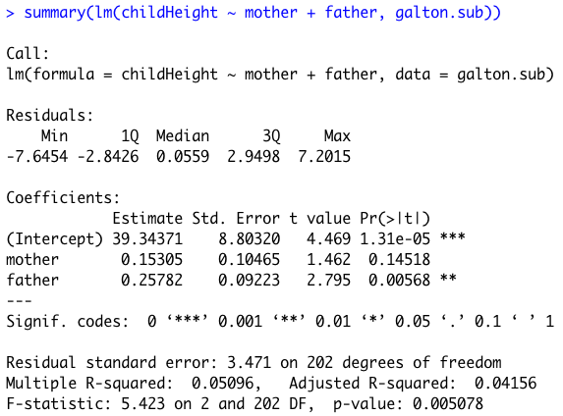
Example: Galton Height Data
Father’s height appears to be the stronger predictor: parameter estimate has greater magnitude and is significantly different from zero

Slide 43
Third Variable: Child Gender
We’d like to see how the child’s gender influences the relationship between parental height and child height:
Does the relationship between parental height and child height look different for male vs. female children?
Is there an interaction between gender and parental height?

Slide 44
How to Detect Interaction
Graphically
Plot the relationship between the IV and the DV separately for each value of the modifying variable
Analytically
In addition to the main effects of the two IVs, include an interaction term in your regression model
If the term is statistically significant, interaction is present
DV
Group A
Group B
IV

Slide 45
Interaction in Multiple Regression
An interaction term in regression is the mathematical product of the main effects
At least one of the main effects must be significant to test for interaction
If the interaction term is statistically significant, conclude that interaction exists; otherwise interaction is not present

Slide 46
Example: Height Data
Do separate scatterplots for Male and Female children:
Paternal height predicting child height
Maternal height predicting child height
Four scatterplots altogether
Add a trend line to each
Is there evidence of a possible interaction?
Do the slopes look different, comparing male and female children?

Slide 47
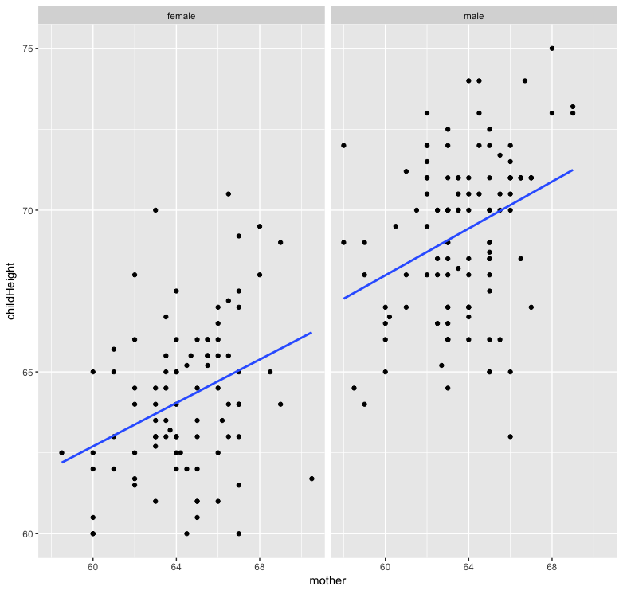

Slide 48
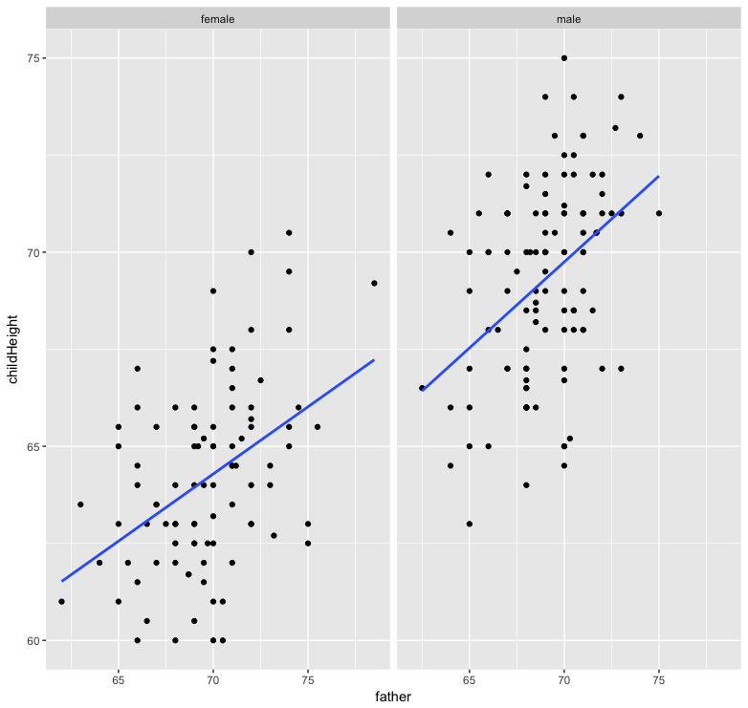

Slide 49
Example: Height Data
Run a new regression model, consisting of three IVs: maternal height, paternal height, and male gender (0/1)
Is male gender a significant predictor of child height?
How does including this change the significance of the other two variables?
Run a new model containing all five IVs
Maternal height, paternal height, male gender, and the two interaction variables
Is there evidence of interaction between parental height and child gender?
Are interaction terms significant?

Slide 50
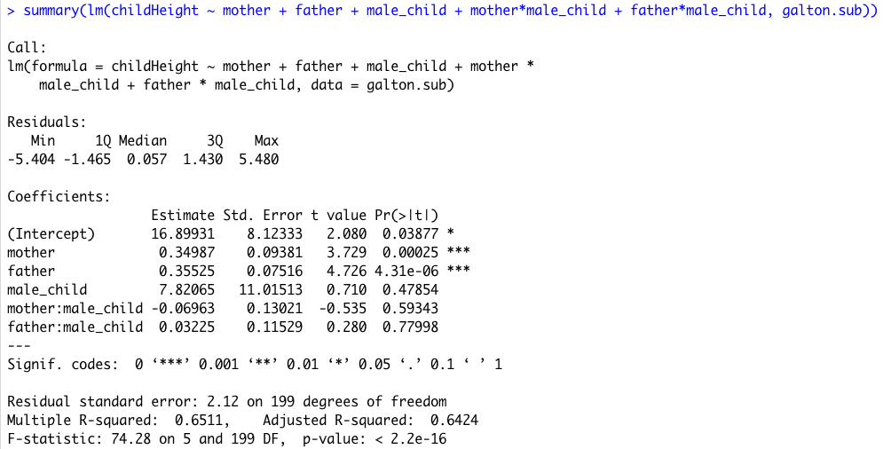
Height Data Interaction Model Results
Neither interaction term is significant, confirming the patterns we saw in the scatter plots

Slide 51
Interaction Model
ChildHt = β₀ + β₁MomHt + β₂DadHt + β₃MaleChild + β₄Male*MomHt + β₅Male*DadHt
MaleChild is a binary variable=1 for Male, =0 for Female
So this results in separate regression lines for Males and Females having different intercepts and slopes
Males:
Females:
So testing for different slopes amounts to testing whether β₄=0 and β₅=0
ChildHt = (β₀ + β₃) + (β₁+β₄)MomHt + (β₂+β₅)DadHt
ChildHt = β₀ + β₁MomHt + β₂DadHt

Slide 52
The Final Model
Given all of these different regression models, how to we choose the best one to represent the relationship between parental height, child gender, and child height?

Slide 53
Model Building Strategies

Slide 54
Goodness-of-Fit vs. Complexity
Goodness-of-fit refers to how well the model represents the data
Complexity is how many terms there are in the model

Slide 55
Principle of Parsimony
Balancing act between goodness-of-fit and complexity
We want a model that’s simple without sacrificing goodness-of-fit

Slide 56
Which Predictors are Important?
Tests on regression slopes
t tests to determine if coefficients equal zero
Change in explained variation

Slide 57
Partial F Tests
Evaluate nested models
Model 1 has IVs that are a subset of those in model 2
Adding IVs usually improves indices of model fit, but increases complexity
Do the extra variables “pull their weight”

Slide 58
Partial F Tests in R
mod1 <- lm(y ~ x1 + x2, data)
mod2 <- lm(y ~ x1 + x2 + x3 + x4, data)
anova(mod1, mod2)
if F test is significant (p<0.05) then the additional IVs improve model fit enough to justify including them

Slide 59
Collinearity
Collinearity occurs when the X variables are highly correlated with each other
This causes computational difficulties with estimating the regression coefficients
If collinearity is severe enough, coefficients can’t be estimated
Detect collinearity by calculating the correlations between the X variables

Slide 60
Dealing With Collinearity
Eliminate redundant variables if possible
Use principal components analysis (PCA) as a method of data reduction
Makes an index out of correlated variables
This is the subject of a future lecture (Nov. 17)

Slide 61
Model Fit Indices
Adjusted r²
Like r² for SLR, but takes into account the number of variables in the model
Larger is better (more variability explained)
AIC and BIC
“Information criteria”, accounts for both number of variables and sample size
Smaller is better (more parsimonious)

Slide 62
Class Exercise: Iterative Model Fitting
Use the clouds dataset from the HSAUR package
Rainfall is the dependent (outcome) variable
We are interested in how seeding affects rainfall
See example in text for evaluation of interaction
We will do an iterative model fitting procedure, as in HW #2
First, run SLR with each variable in dataset
Second, determine order they will go in model
Usually based on science/theory behind study
Also based on statistical criteria such as strength of relationship with DV
Third, add variables one at a time, evaluating improvement of fit at each iteration
When model fit ceases to improve by the addition of more variables, this is the final model

Slide 63
Clouds Example
SLR models: only two variables were significantly associated with rainfall, these will be put in MLR model
Variables not significant on their own are not likely to become significant when in the model with other, more significant variables
They don’t explain much additional variability
MLR model consists of time + sne
Sne not significant, does not improve model fit
Variable is removed
Final model is SLR consisting of time alone

Slide 64
Polynomial Regression

Slide 65
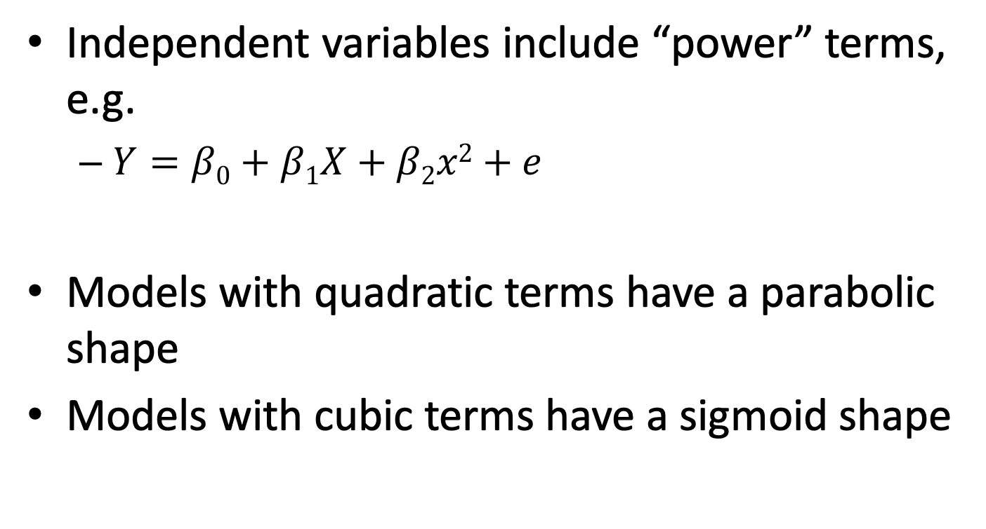
Polynomial Regression
Independent variables include “power” terms, e.g.
$Y=β0+β1X+β2x2+e$
Models with quadratic terms have a parabolic shape
Models with cubic terms have a sigmoid shape

Slide 66
Trees Data
Recall the residuals plots from the SLR models
Did not look like random scatter
Suggested non-linearity
We will now formally evaluate whether adding polynomial terms improves model fit

Slide 67
Example: Trees
Data trees
Fit two linear regression models, each having Volume as the dependent variable (Y)
Model 1: Volume as a function of girth
Model 2: Volume as a function of both girth and girth²
Compare the fit of the two models
Which one seems to fit the data better?

Slide 68
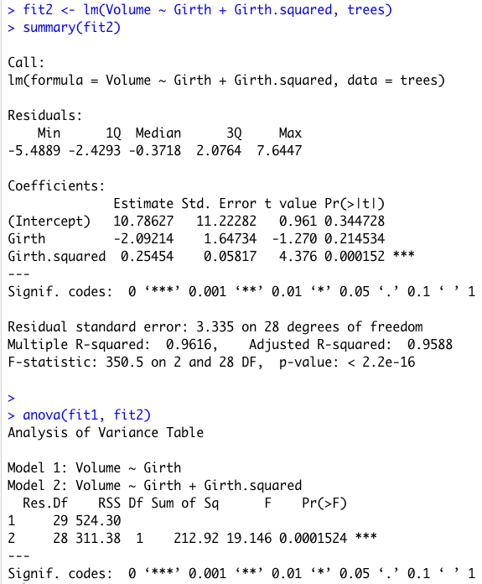
Trees Polynomial Regression Results
Fit improves with addition of quadratic term (girth²)

